Slide 1
vtk.js Architecture and Tooling

Slide 2



Acknowledgments
Presented By:
Forrest Li (Kitware)
Contributors:
Forrest Li (Kitware)
Trinity Urban (MGH and OHIF)
Steve Pieper (Isomics)
Erik Ziegler (OHIF)
Gordon J. Harris (MGH and OHIF)
James A. Petts (OHIF)
Danny Brown (OHIF)
Stephen Aylward (Kitware)

Slide 3
Funding Sources
VTK.js / Kitware
NIH NINDS R44NS081792
NIH NINDS R42NS086295
NIH NIBIB and NIGMS R01EB021396
NIH NIBIB R01EB014955
Isomics
NIH P41 EB015902
OHIF
NIH U24 CA199460

Slide 4
Course Outline
Introduction to vtk.js and OHIF
Starting a vtk.js project
vtk.js: Architecture, itk.js, widgets, and more
OHIF + vtk.js integration
Advanced vtk.js: WebGL and GLSL

Slide 5
Architecture Overview
Datatypes: Image data, geometry/unstructured data
Filters: Transform or generate data
Rendering: How data is colored, represented, and placed
Interaction: Control view of scene or interact with actors in a scene
I/O: Read data into vtk.js
Proxy: An abstraction that centralizes handling of typical pipelines
Remote: Communication and serialization of data

Slide 6
Data Types

Slide 7
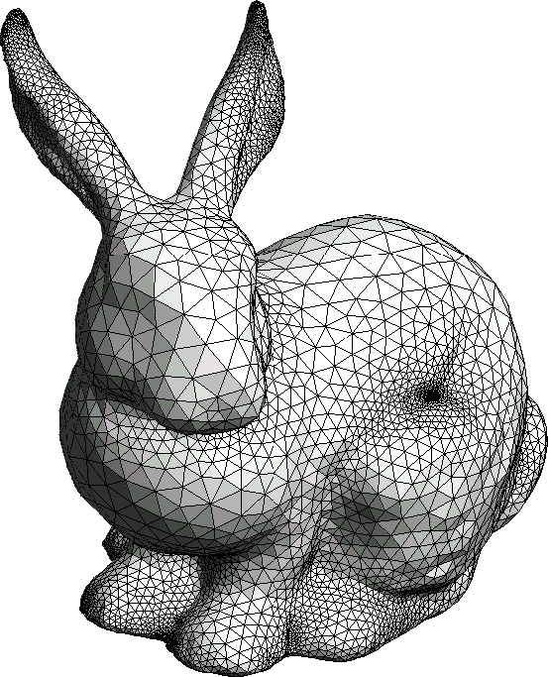
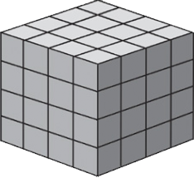
Data Types
vtkDataArray: A wrapper around typed arrays with extra metadata
vtkDataSet: abstract class that stores dataset attributes
vtkImageData: 3D volumetric data (i.e. on a structured grid)
vtkPolyData: geometry data (i.e. unstructured point clouds, surfaces)

Slide 8
vtkDataArray
Represents a typed array with extra metadata
Name
Datatype: the type of typed array (Uint8, Uint16, etc.)
Size
Number of components: tuple size
Range: min/max of data
Access via individual elements in array, or as tuples
Useful for extracting multicomponent elements
e.g. RGB elements, 2D/3D space coordinates

Slide 9
vtkDataSet
Abstract class that provides stored dataset attributes
Point data
Cell data
Field data
Point Data: Data associated with dataset points
Cell Data: Data associated with dataset cells
Field Data: Unstructured data
not associated with specific dataset attributes

Slide 10
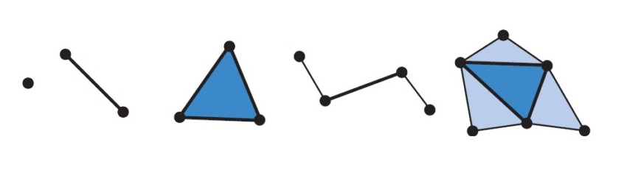
Points, Cells, Fields
Points: vertices, locations in 3D space
Cells: Ordered set of points
Defines a topology, e.g. lines, triangles, tetrahedrons, etc.
Fields: data representable as fields

Slide 11
Image Data: vtkImageData
Structured data on a grid
Properties:
Extent (i.e. dimensions)
Origin
Spacing
Orientation
Examples: volumes, slices

Slide 12
Example Usage: ImageData
const imageData = vtkImageData.newInstance({ origin: [0, 0, 0], spacing: [1, 1, 1], direction: [1, 0, 0, 0, 1, 0, 0, 0, 1], }) Const dataArray = vtkDataArray.newInstance({ numberOfComponents: 1, Values: new Float32Array(<voxel values>), }) imageData.getPointData().setScalars(dataArray) imageData.setDimensions([50, 50, 50])

Slide 13
Geometric Data: vtkPolyData
Vertices, polygonal surfaces, etc. in 3D space
Properties:
Points/Vertices
Lines
Triangle strips
Polygons
Examples: Point clouds, surfaces, contours

Slide 14
Example Usage: PolyData
const polyData = vtkPolyData.newInstance() Const vertices = new Float32Array(<xyz coords>) Const polys = new Uint32Array(<poly definitions>) polyData.getPoints().setData(vertices, 3) polyData.getPolys().setData(polys);
Format: [4, p₁, p₂, p₃, p₄, 4, ...]

Slide 15
Other Useful Data Models
You can find more in Sources/Common/DataModel/
PiecewiseFunction
ScalarsToColors/ColorTransferFunction
Box/Cone/Cylinder
Splines
BoundingBox

Slide 16
Filters and Pipelines

Slide 17
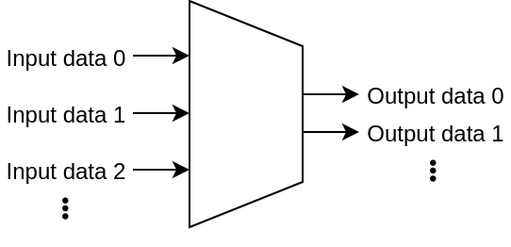
Filters and Data Pipelines
VTK.js filters modify and transform data in a meaningful way
Is an algorithm with N inputs and M outputs
Example filters:
Image cropping filter
Polydata smoothing filter
Mesh decimation filter

Slide 18
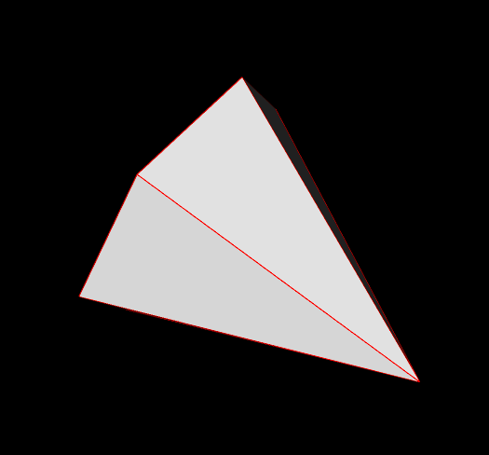
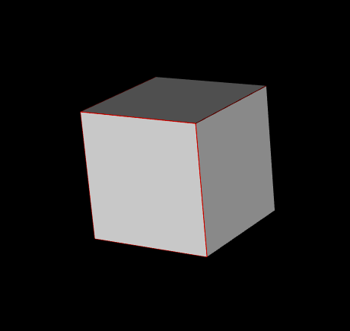
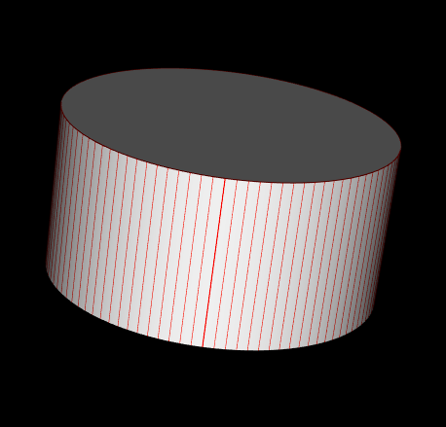
Sources: Data-generating Filters
Sources: filters that take 0 inputs and returns 1 or more outputs
Examples:
ConeSource
CubeSource
CylinderSource
RTAnalyticSource

Slide 19
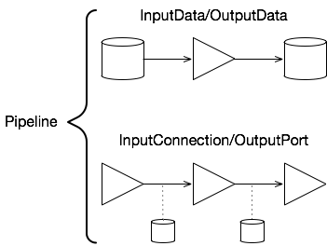
Filters and Data Pipelines
Filter connectivity affects pipeline construction
setInputData() / getOutputData()
Sets/Gets the input/output dataset from the filter
setInputConnection() / getOutputPort()
Sets/Gets the input/output connection link
This link is lazily evaluated when the filter needs to be updated

Slide 20
Filters and Data Pipelines
Data can be used in many filter pipelines
Useful for generating multiple representations of data for visualization
Filter
Filter
Filter
data
Filter
Filter
Filter

Slide 21
Pipeline Example
var filter1 = vtkSomeFilter.newInstance() var filter2 = vtkSomeFilter.newInstance() var filter3 = vtkSomeFilter.newInstance() var filter4 = vtkSomeFilter.newInstance() filter3.setInputConnection(filter2.getOutputPort()) filter2.setInputConnection(filter1.getOutputPort()) filter4.setInputConnection(filter1.getOutputPort())
Filter 2
Filter 3
Filter 1
Filter 4

Slide 22
Anatomy of a Filter
publicAPI.requestData = (inData, outData) => { const indata1 = inData[0] const indata2 = inData[1] …<perform some work>…
outData[0] = outdata1; outData[1] = outdata2; }

Slide 23
Anatomy of a Filter
Setting/Getting input data:
setInputData(obj, port = 0)
getOutputData(port = 0)
Setting/Getting connections:
setInputConnection(conn, port = 0)
getOutputPort(port = 0)

Slide 24
Anatomy of a Filter
macro.algo(publicAPI, model, <number of inputs>, <number of outputs>)
Adds methods to make this object a filter
getInputData, getInputConnection
getOutputData, getOutputPort
For a variable number of inputs, use:
addInputData(data)
addInputConnection(conn)
More info on macro and vtk.js classes: https://kitware.github.io/vtk-js/docs/develop_class.html

Slide 25
Filters and Pipelines
Filters and pipelines can help preprocess your data
Map data from one datatype to another
Combine datasets together
Extract key elements of interest
Augment datasets with extra information
Generate new data from descriptions
...and more!

Slide 26
Rendering

Slide 27

Rendering Overview
WebGL rendering
Supports both WebGL 1 and WebGL 2, but WebGL 2 is preferred
Customizable visualization pipeline
Interactions and widgets

Slide 28
Rendering Overview
Data/Source
Filters
Mapper
Actor
Renderer
Interactions

Slide 29
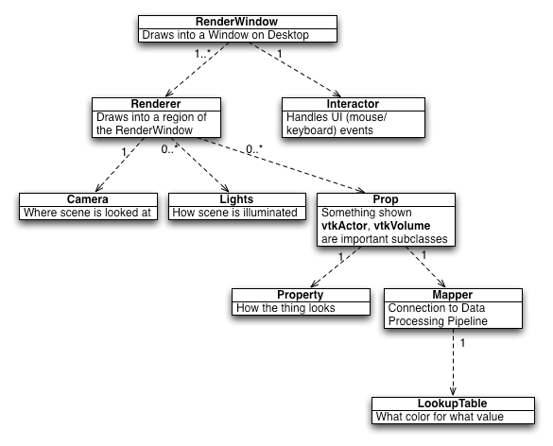
Key Components
RenderWindow
Container for Renderers
Delegates user interactions
Interactor
Listens for and handles user interactions
Delegates interaction events to an InteractorStyle
InteractorStyle (not shown)
Translates events into actions
Example: TrackballCamera, ImageInteractorStyle

Slide 30
Key Components
Renderer
Region of the screen that contains content
Contains Cameras, Props, and Lights
Camera
Where and how the scene is viewed
Lights
Controls illumination of the scene

Slide 31
Key Components
Prop
Actors/Volumes
An object that represents some element being rendered
Property
Controls how a Prop looks
Rendering properties
Mapper
Transforms data into graphics primitives
Props delegate drawing of data to the Mapper
LookupTable maps data values to color, opacity, etc.

Slide 32
Actors and Mappers
vtkActor and vtkMapper
Used for most geometry data
vtkImageSlice and vtkImageMapper
Used for rendering image slices
vtkVolume and vtkVolumeMapper
Used for rendering volumes
vtkGlyph3DMapper
Renders the same geometry in multiple places as a glyph

Slide 33
Actor Property
actor.getProperty()
Controls various aspects of rendering
Ambient shading
Diffuse shading
Lighting interpolation
Image color window and level
Volume color transfer function
Different actors have different properties
vtkActor has vtkProperty
vtkImageSlice has vtkImageProperty
vtkVolume has vtkVolumeProperty

Slide 34
Lookup Table
Mapper utilizes lookup tables to draw and color data
Pixel values are mapped through a lookup table
Values determine rendered color
ColorTransferFunction
Maps scalars into colors
PiecewiseFunction
Maps scalars to scalars
Example usage: pixel value to opacity

Slide 35
Visualization Pipeline
Interaction
RenderWindow
Renderer
Filter
Mapper
Actor
Property
data
Mapper
Actor
Property
Data Processing
Visualization

Slide 36
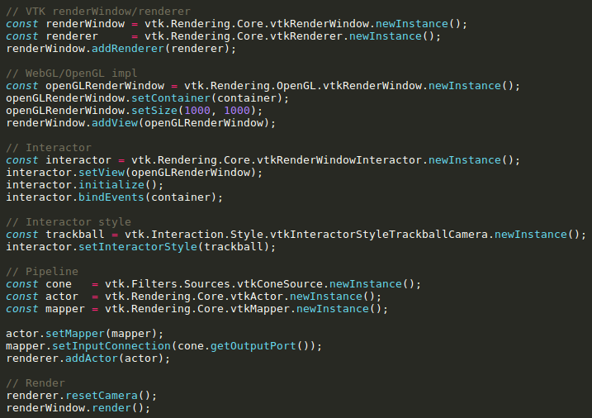
Visualization Pipeline

Slide 37
Interaction and Widgets

Slide 38

Interaction
Supports mouse and touch interactions
Scene picking
Display-to-scene coordinate conversion
Several built-in interactions:
3D Trackball camera
Image slicing
window/level on slices

Slide 39
Interaction
Interactor
Bound to RenderWindow
Delegates user events to the InteractorStyle
InteractorStyle
Handles user events and performs actions
Per-event handlers (e.g. mouse move, left button click)
Examples: TrackballCamera, ImageInteractorStyle

Slide 40
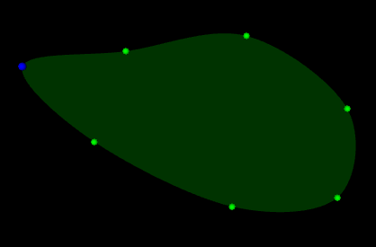
Interaction: Widgets
Widgets combine interaction and scene objects to manipulate data
3D widgets
2D widgets achieved via plane projection
Allows users to interact with data in various ways
Image cropping
Segmentation
Surface cutting

Slide 41
Widget Architecture
Deduplication of state
Previous architecture required widgets across multiple renderers to communicate state
Separation of concerns
Previous architecture tied behavior and state in the representation
Ease of representation synchronization
Single event-emitting state can synchronize various types of representations independently of one another

Slide 42
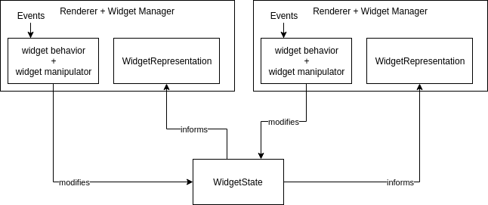
Widget Architecture
Widget architecture is MVC (model view controller)
Model: widget state (shared between widget instances)
View: representations (across multiple renderers/render windows)
Controller: behavior that translates interactions on representations into mutations on widget state

Slide 43
Picking
Two types of picking: vtkPicker and vtkHardwareSelector
vtkPicker
Casts ray into scene
Picks first actor that intersects with ray
vtkHardwareSelector
Color-based picking
Render each actor as a unique color, and map that color back to the actor
Process: render picking buffer, then render regular scene

Slide 44
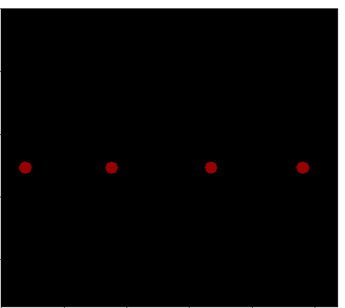
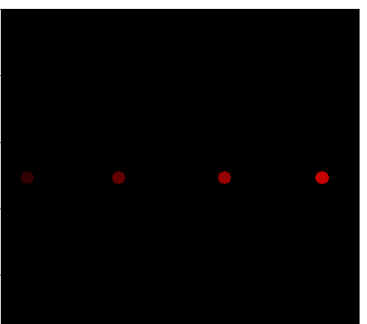
Picking
Widgets are picked in-scene using color picking
Fast picking in scenes with many actors
Can use ray-based picking inside widget as well
Regular render buffer
Color picking buffer

Slide 45
Widget Manager
vtkWidgetManager
Bound to a Renderer
Manages widgets with representations in Renderer
Updates color picking buffer when view changes
Controls how widget focus works
Have a single widget constantly focused
Widget focus depends on picking the widget

Slide 46
Widget Usage
widget = vtkSomeWidget.newInstance()
Creates a widget factory instance
Contains an initial widget state to be shared with all factory-produced widgets
viewWidget = widgetManager.addWidget(widget)
Creates a a widget instance bound to a renderer
Contains the logic to translate interactions into state mutations
Holds a link to the widget state stored in the widget factory instance

Slide 47
I/O, itk.js, Proxies, and Remote

Slide 48
IO: Readers and Writers
vtk.js comes with the following readers and writers:
XML image and poly data (.vtp, .vti)
Geometry: STL, OBJ
Molecular: PDB
Scene-related: elevation, skybox, etc.
Data access helpers help fetch remote datasets
HttpDatasetHelper
All IO can be found in Sources/IO

Slide 49

IO with itk.js
Provides readers for many other file types
Images: nrrd, mha, dicom, and more
Geometry: exo, vtk, vtp
Meshes: obj, stl, fsa, and more
ITKHelper
convertItkToVtkImage
convertVtkToItkImage

Slide 50
itk.js
Cross-compiled ITK functionality into web assembly
Brings many ITK modules to the web
Readers
Filters
Facilitates building C++ extensions for the web
More info can be found in the itk.js repo: https://github.com/InsightSoftwareConsortium/itk-js/
vtk.js and itk.js glue: ITKHelper

Slide 51
Proxy Architecture
Proxy interface for higher-level pipeline management
Inspired by ParaView’s proxies
Allows for a unified API for controlling local or remote pipelines
Easy pipeline creation
Local
Proxy API
Remote

Slide 52
Proxy Architecture
Sources
A source of data
Raw data, filters, etc.
Representations
Bundles the appropriate actor, mapper, and properties for rendering data
e.g: SliceRepresentationProxy
Views
Creates a pre-defined view setup with appropriate interactors
Ex: 2D view, 3D view

Slide 53
Proxy Architecture
Proxy Manager is the central store for state
Configuration-based wiring
Source-Representation-View pipelines
View types
Misc proxies (e.g. LookupTable and PiecewiseFunction)
Lifecycle management
Pipelines
Data sources
Representations and Views

Slide 54
Proxy Configuration
Define classes for sources, representations, and views
Expose desired properties on the classes
Sync properties across different objects
Define how data should look in different view types
Example configuration: paraview-glance/src/config/config.js

Slide 55
Remote Resources with vtk.js
Remote visualization
Server-side VTK rendering
Remote processing
Server-side data processing

Slide 56
Remote Visualization
vtk.js cannot handle very large datasets
Browser limitation
Server-side VTK rendering
Two strategies:
Server-side render, then send reduced geometry
Server-side render, then send images

Slide 57
Downsampled Datasets
Server sends downsampled data
Leverages all of local vtk.js rendering and interaction capabilities
Doesn’t get full-resolution data
Good for machines capable of using vtk.js and WebGL

Slide 58
Remote viewing
Server sends images of scene
Interactions are sent to server for processing
Interactions processed server-side
Server renders full-size datasets remotely
Good for full-dataset rendering if downsampling is not sufficient

Slide 59
Remote Processing
Offloads processing of datasets to a remote server
Client-side processing is slow
JS and WebAssembly still has limitations
Dataset source
Datasets already stored remotely
Upload local datasets to remote server
wslink: transport protocol
Utilize vtk-python or itk-python server-side

Slide 60
Remote Processing: wslink
RPC and pub/sub library written in Python
Based on websockets
Bidirectional
Supports binary blobs
No HTTP header overhead
Persistent connection
vtk.js datatypes can be serialized via getState()
Find more info here: https://github.com/Kitware/wslink/

Slide 61
Remote Processing: ITK-python
ITK-Python is a Python wrapper for ITK
Provides a Pythonic interface for ITK functionality
https://itkpythonpackage.readthedocs.io/en/latest/
image = itk.imread(input_filename) smoothed = itk.median_image_filter(image, radius=2)

Slide 62

vtk.js Architecture
Want to learn more? Check out the docs: https://kitware.github.io/vtk-js/docs/
Have questions? Check out the Discourse: https://discourse.vtk.org/c/web

Slide 63
Next Time
Next course (#4):
The OHIF Platform

